Slide 1
Acl v1r30p17 – v1r27p17 Filter channel RESET/LACTH comparison

Slide 2
Channel names
Test setup
Loop frequency : 10KHz
_ld_ means LONG double computation
noise_flt_{,ld}_1: noise generated at the loop frequency and then filtered
noise_flt_{,ld}_5: noise generated at the 5 times the loop frequency and then filtered
noise_flt_extend_{,ld}_5: noise generated at the loop frequency, extended at 5 times the loop frequency and then filtered
noise_flt_average_1: noise generated at the 5 times the loop frequency and then decimated at the loop frequency by averaging
noise_flt_last_1: noise generated at the 5 times the loop frequency and then decimated at the loop frequency by taking the last sample

Slide 3
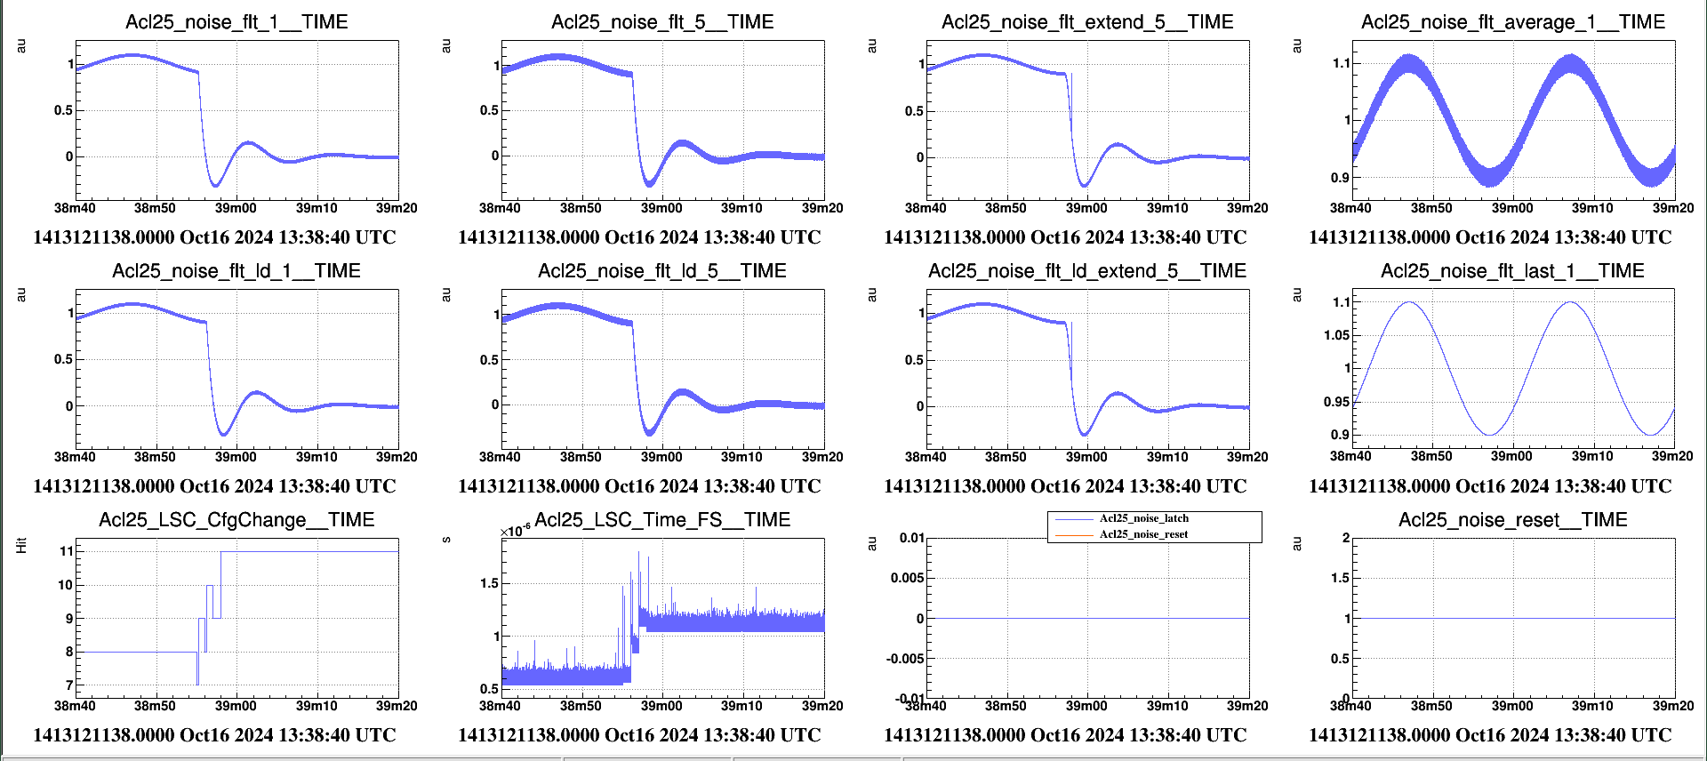
Filter transition
Several issues with the current Acl version ( <= v1r27p17)
The ramp time defined in the Cm message to update the filter was not taken into account: it was always equal to 1
In case of a burst of updating filters with the «apply» command, the following forces the switching of the previous even if it applied on a different channel
case of low pass filter to high pass filter transition with a ramp time of 4.33s

Slide 4
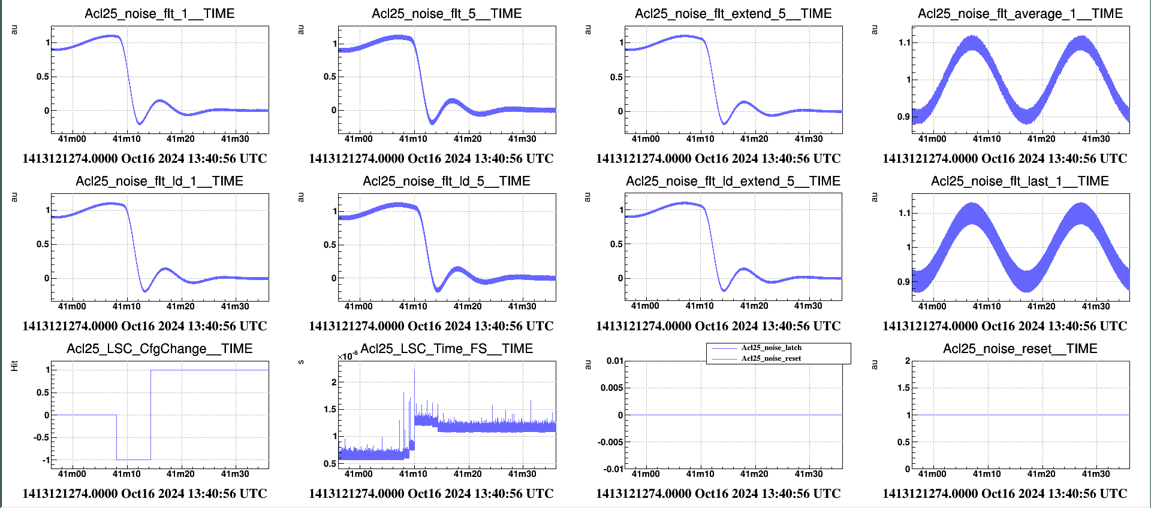
Filter transition
Acl version v1r30p17
The ramp time defined in the Cm message to update the filter is taken into account
In case of a burst of updating filters with the «apply» command, the filters updates are done independently.
case of low pass filter to high pass filter transition with a ramp time of 4.33s

Slide 5
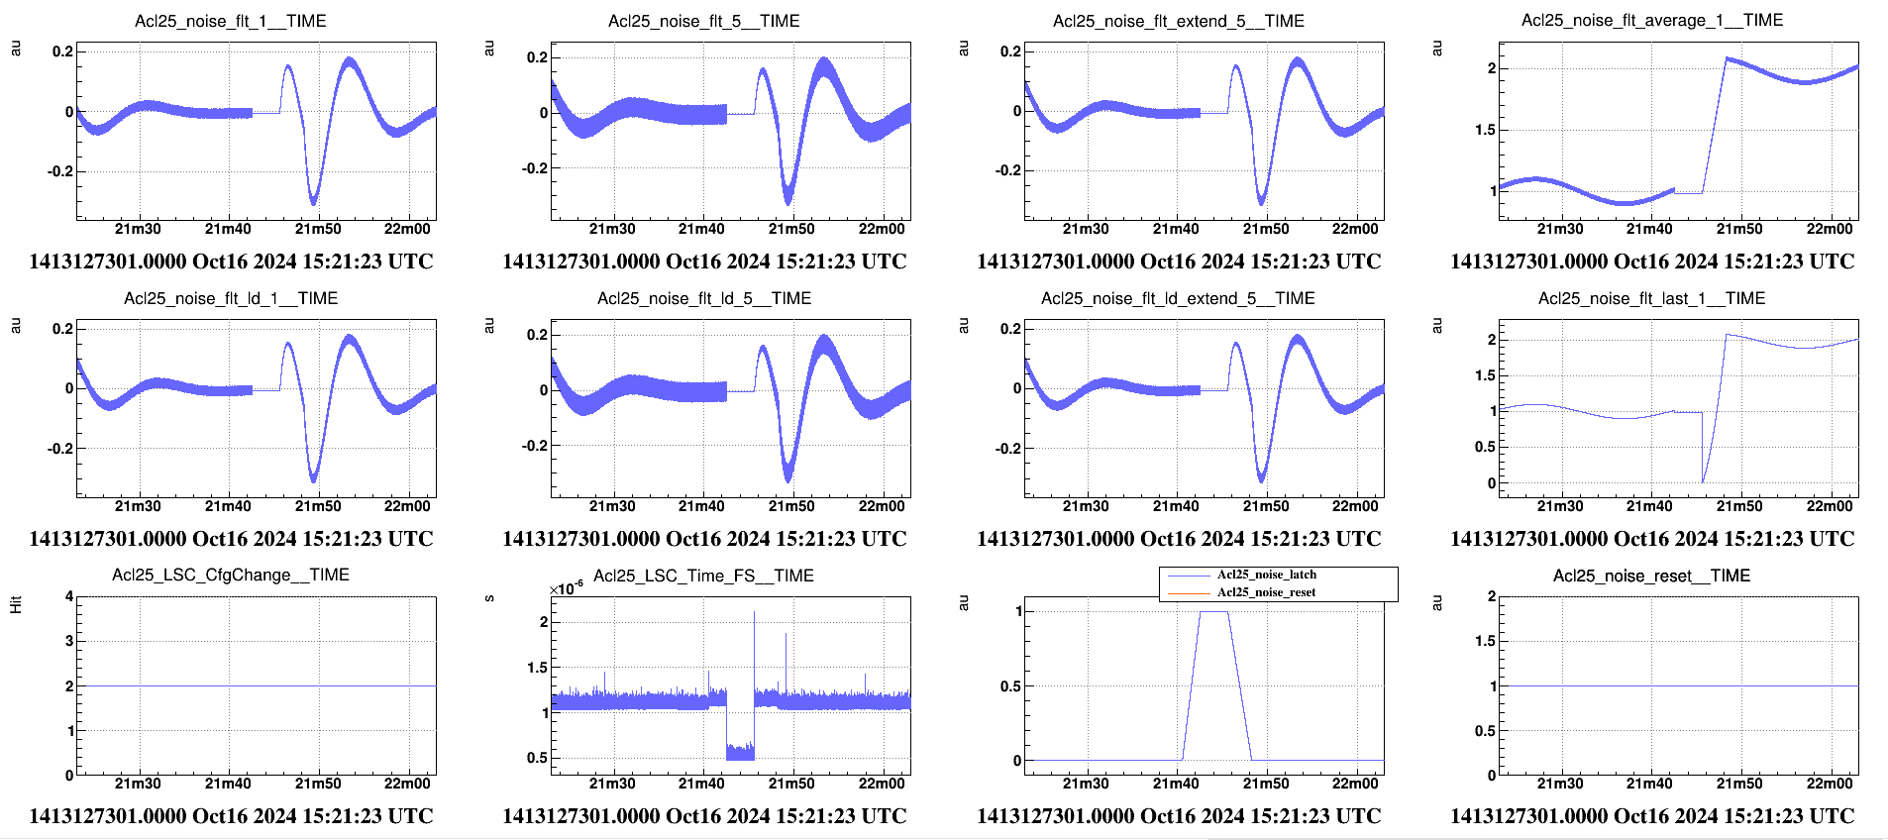
LACTH{,_MEM} – transition with a ramp
Several issues with the current Acl version ( <= v1r27p17)
With the LATCH at 1 , no more filter channel computation : as consequence it is impossible to change a filter and a filter reset is required when the LATCH is lower than 1.
The reset shape is applied only at the input signal, not at the output signal
Improve the logic in case of a reset and a latch occurred at the same time: today the latch is more priority than the reset and requests a filter reset
case of channel high-pass filtered

Slide 6
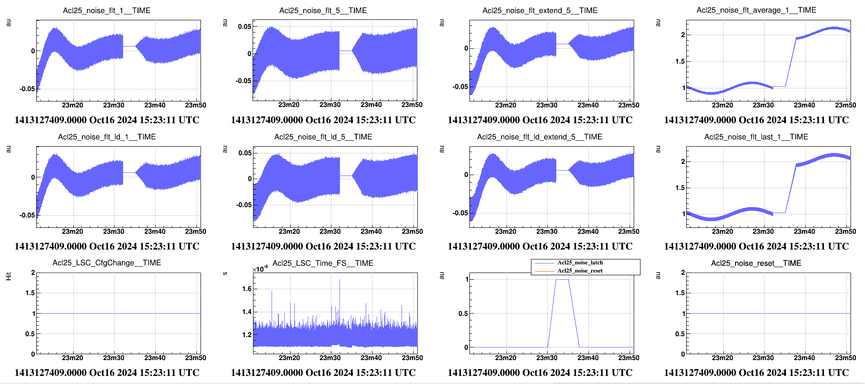
LACTH{,_MEM} – transition with a ramp
Acl version v1r30p17
With the LATCH at 1 , the filter channel computation is still performed : smooth transition when the LATCH is lower than 1.
The reset shape is applied at the input signal and at the output signal
Improve the logic in case of a reset and a latch occurred at the same time: the reset is more priority than the latch
case of channel high-pass filtered

Slide 7
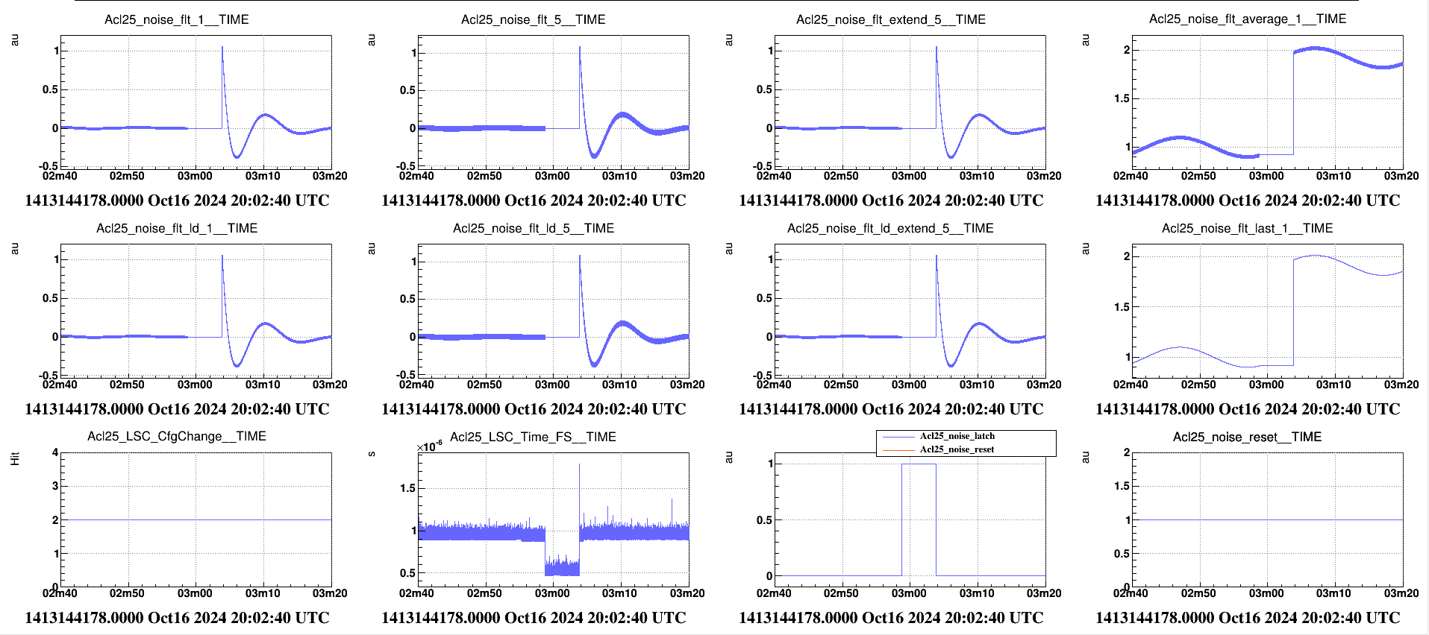
LACTH{,_MEM} – transition in 1 cycle
Several issues with the current Acl version ( <= v1r27p17)
With the LATCH at 1 , no more filter channel computation : as consequence it is impossible to change a filter and a filter reset is required when the LATCH is lower than 1.
The reset shape is applied only at the input signal, not at the output signal
Improve the logic in case of a reset and a latch occurred at the same time: the latch is more priority than the reset and requests a filter reset
case of channel high-pass filtered

Slide 8
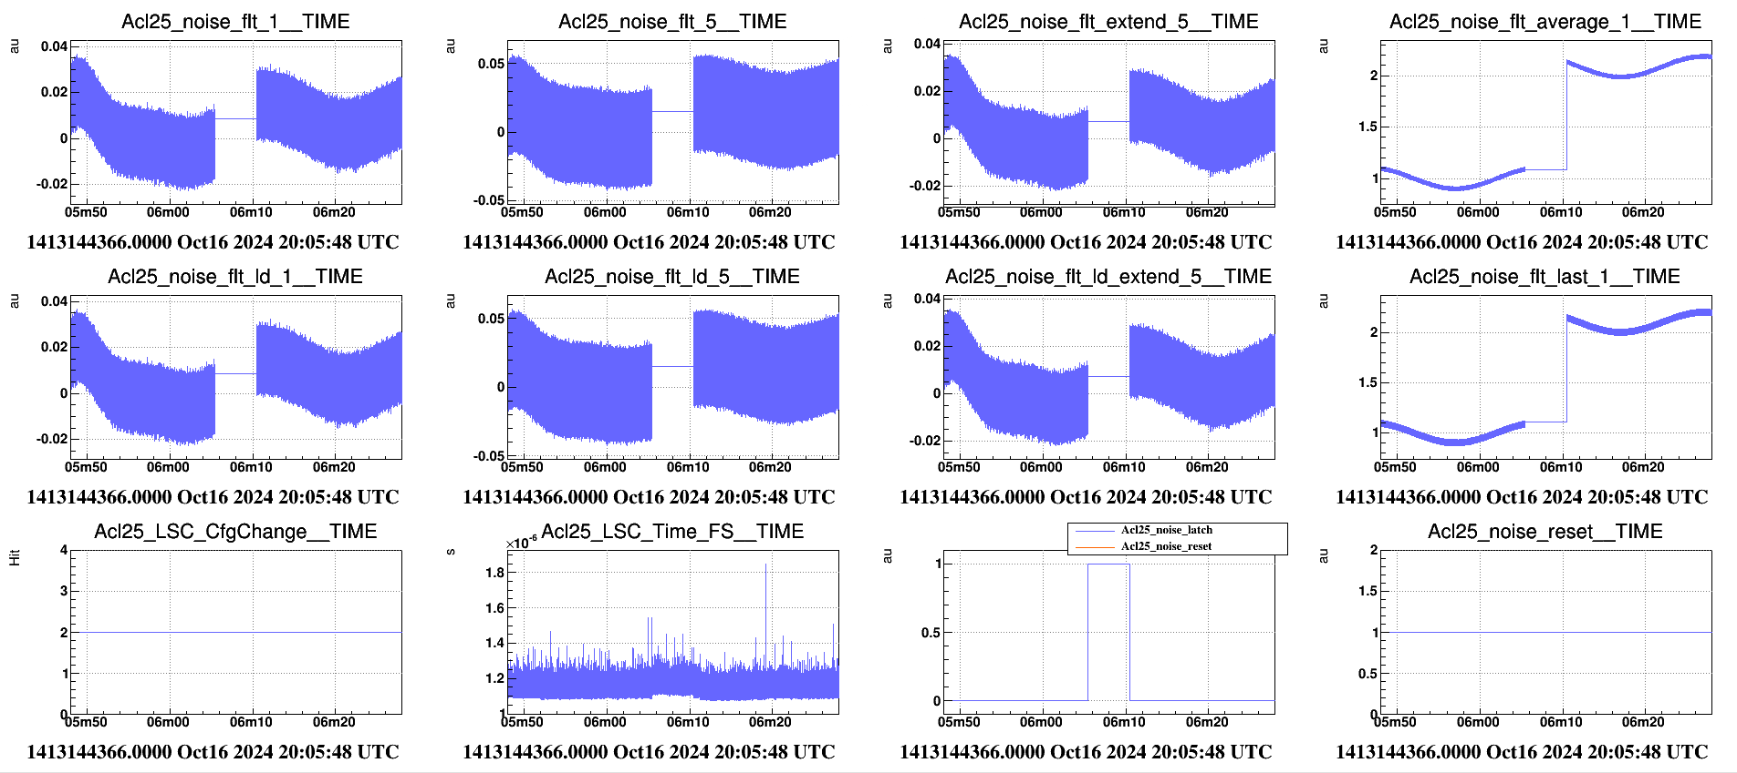
LACTH{,_MEM} – transition in 1 cycle
Acl version v1r30p17
With the LATCH at 1 , the filter channel computation is still performed : smooth transition when the LATCH is lower than 1.
The reset shape is applied at the input signal and at the output signal
Improve the logic in case of a reset and a latch occurred at the same time: the reset is more priority than the latch
case of channel high-pass filtered

Slide 9
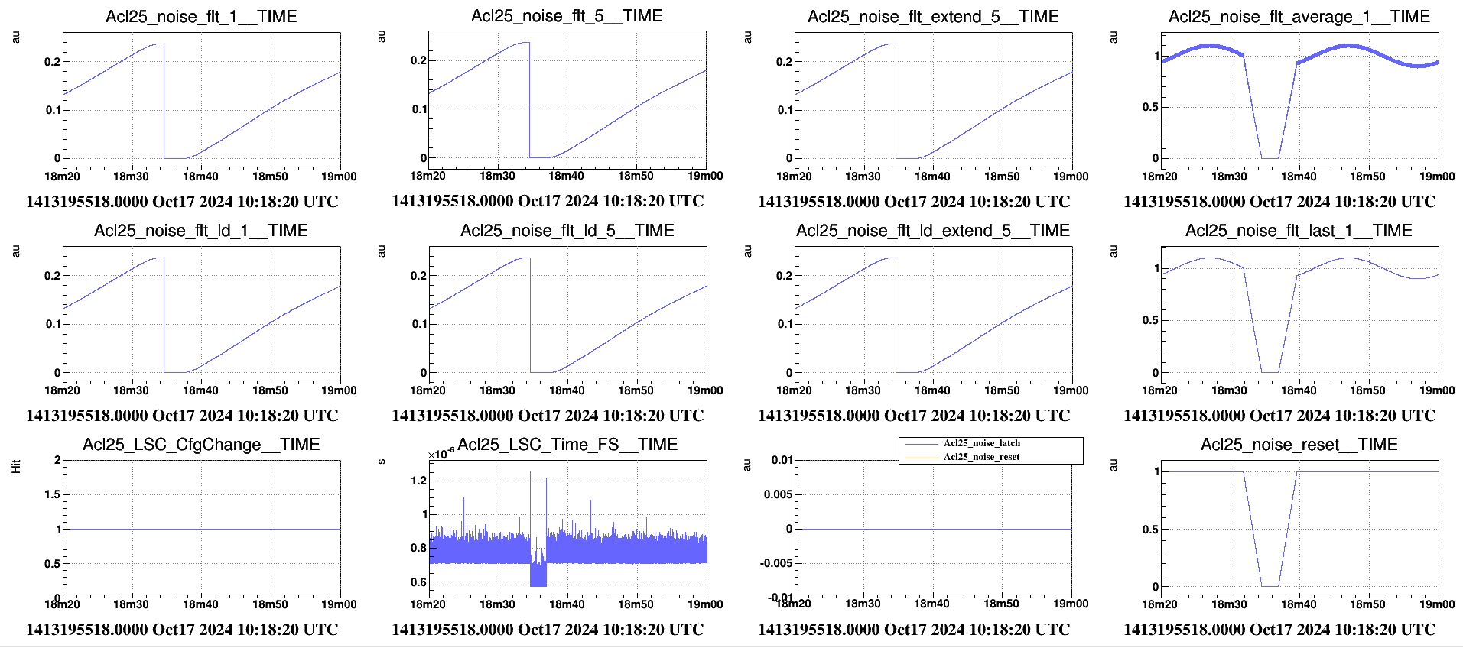
RESET – ramp
Several issues with the current Acl version ( <= v1r27p17)
With the LATCH at 1 , no more filter channel computation : as consequence it is impossible to change a filter and a filter reset is required when the LATCH is lower than 1.
The reset shape is applied only at the input signal, not at the output signal
Improve the logic in case of a reset and a latch occurred at the same time: today the latch is more priority than the reset and requests a filter reset
case of channel with an integrator filter

Slide 10
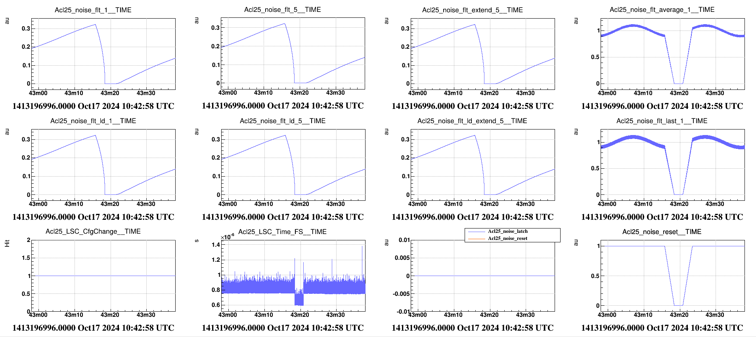
RESET – ramp
Acl version v1r30p17
With the LATCH at 1 , the filter channel computation is still performed : smooth transition when the LATCH is lower than 1.
The reset shape is applied at the input signal and at the output signal
Improve the logic in case of a reset and a latch occurred at the same time: the reset is more priority than the latch
case of channel with an integrator filter

Slide 11
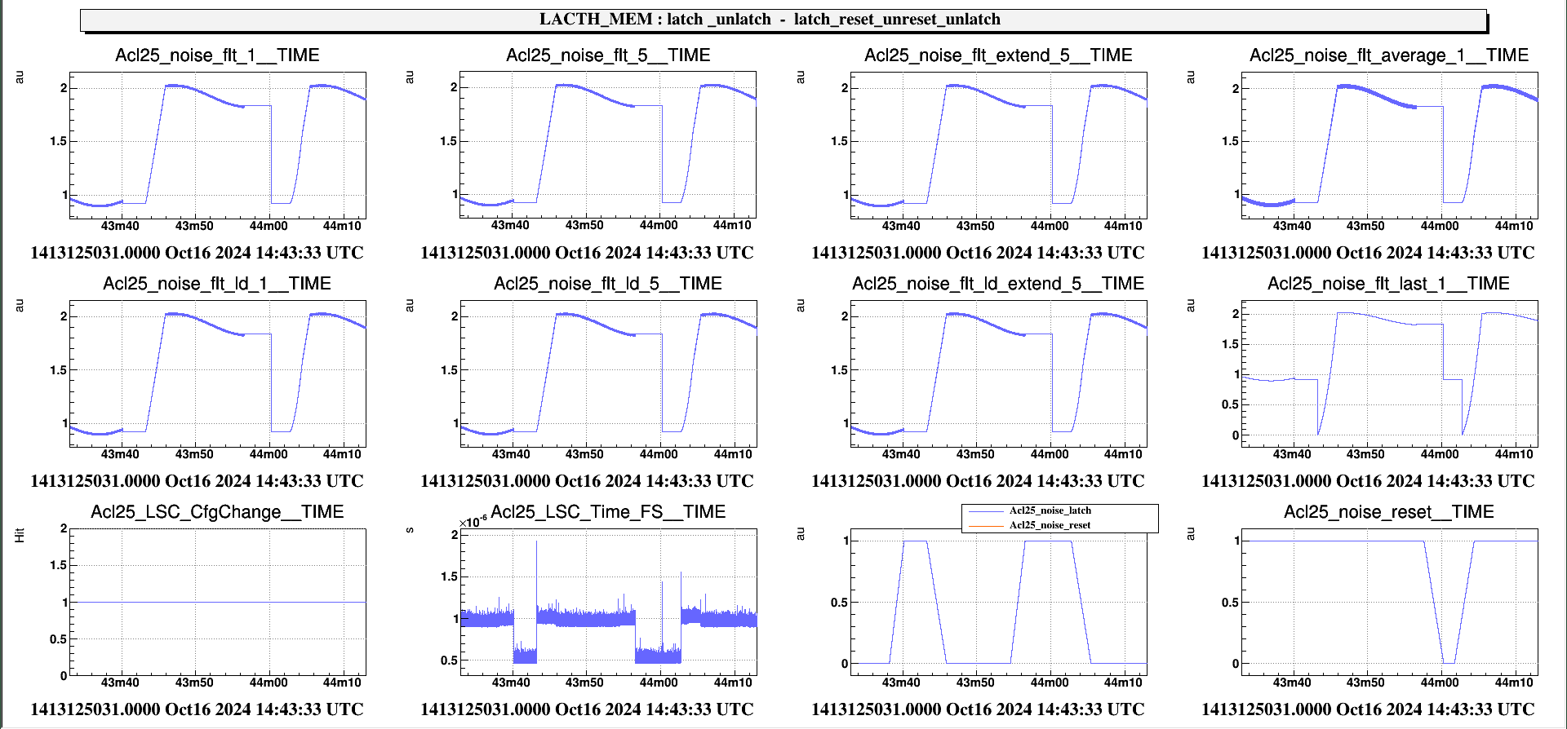
LACTH{,_MEM} - RESET – ramp
Several issues with the current Acl version ( <= v1r27p17)
With the LATCH at 1 , no more filter channel computation : as consequence it is impossible to change a filter and a filter reset is required when the LATCH is lower than 1.
The reset shape is applied only at the input signal, not at the output signal
Improve the logic in case of a reset and a latch occurred at the same time: today the latch is more priority than the reset and requests a filter reset at the unlatch

Slide 12
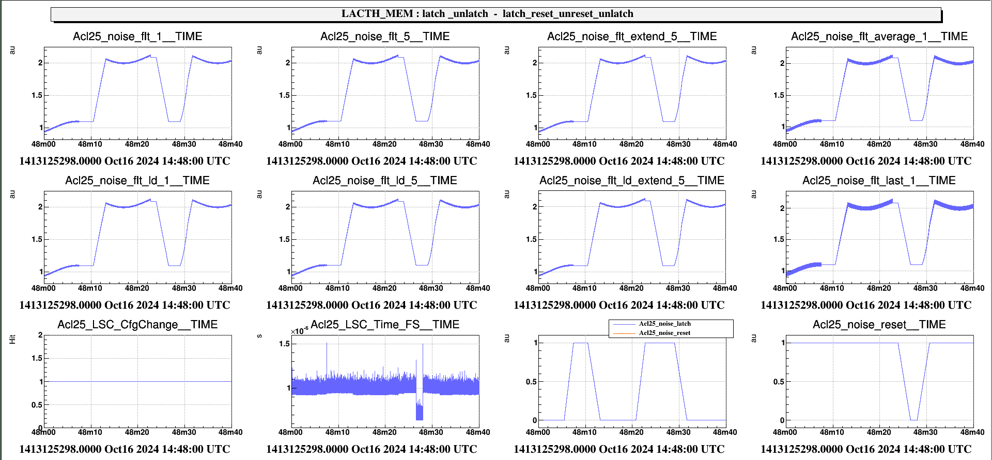
LACTH{,_MEM} - RESET – ramp
Acl version v1r30p17
With the LATCH at 1 , the filter channel computation is still performed : smooth transition when the LATCH is lower than 1.
The reset shape is applied at the input signal and at the output signal
Improve the logic in case of a reset and a latch occurred at the same time: the reset is more priority than the latch, no more filter reset at the unlatch

Slide 13
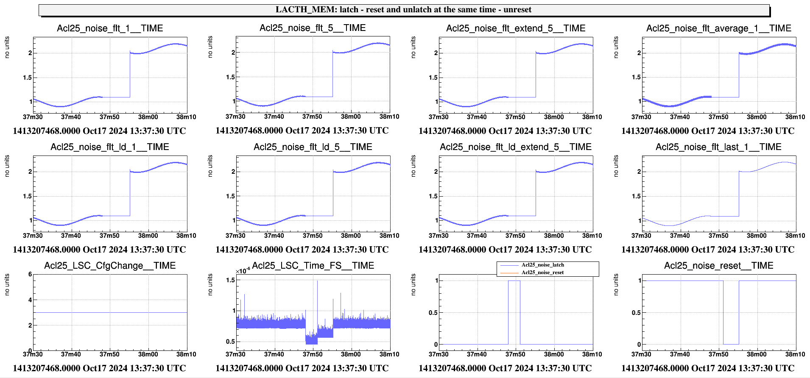
LACTH{,_MEM} – RESET/LATCH priority
Several issues with the current Acl version ( <= v1r27p17)
With the LATCH at 1 , no more filter channel computation : as consequence it is impossible to change a filter and a filter reset is required when the LATCH is lower than 1.
The reset shape is applied only at the input signal, not at the output signal
Improve the logic in case of a reset and a latch occurred at the same time: today the latch is more priority than the reset and requests a filter reset at the unlatch

Slide 14
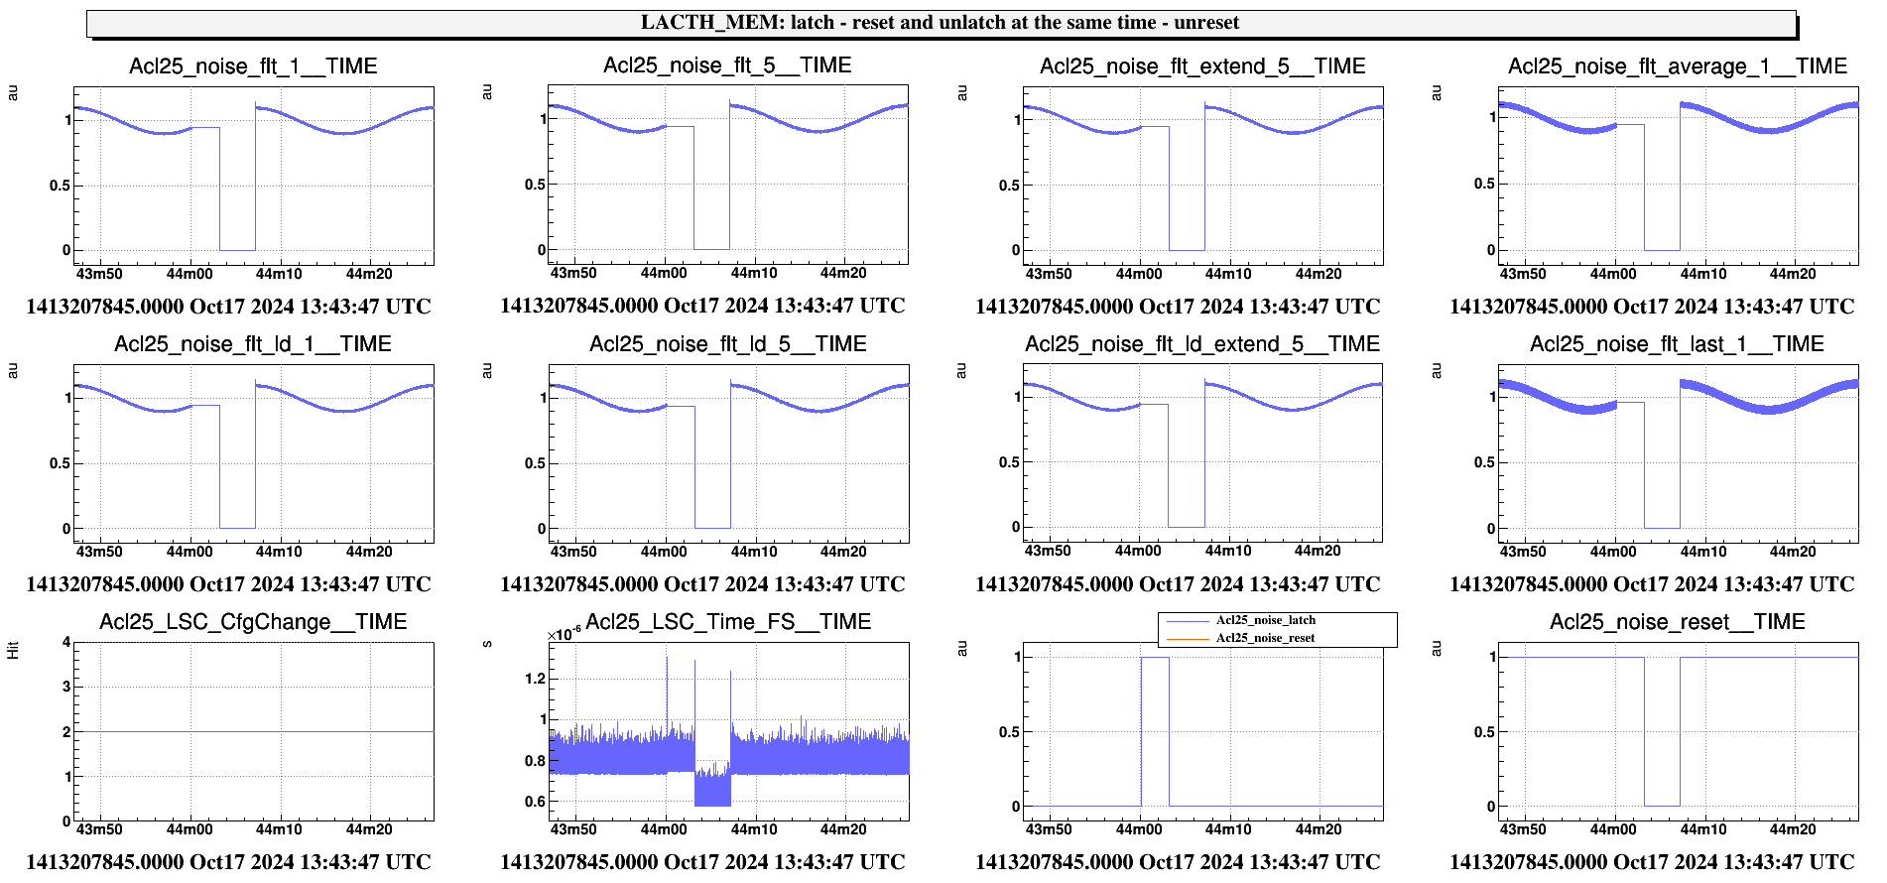
LACTH{,_MEM} - RESET/LATCH priority
Acl version v1r30p17
With the LATCH at 1 , the filter channel computation is still performed : smooth transition when the LATCH is lower than 1.
The reset shape is applied at the input signal and at the output signal
Improve the logic in case of a reset and a latch occurred at the same time: the reset is more priority than the latch, no more filter reset at the unlatch

Slide 15
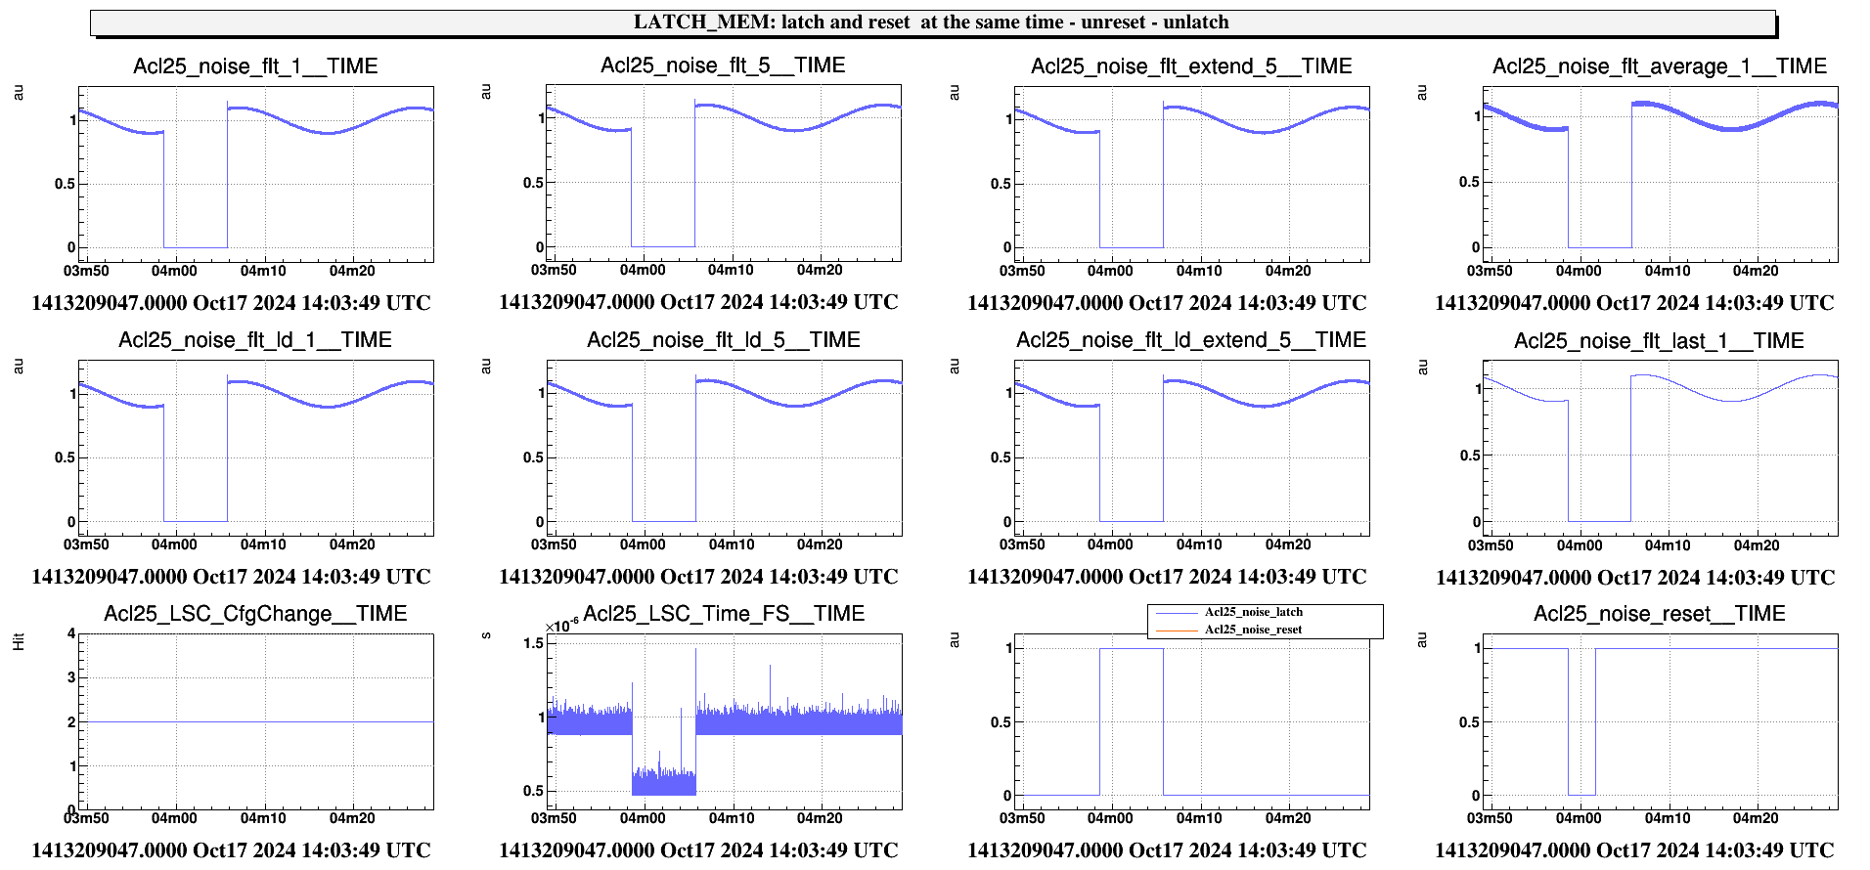
LACTH{,_MEM} - RESET/LATCH priority
Several issues with the current Acl version ( <= v1r27p17)
With the LATCH at 1 , no more filter channel computation : as consequence it is impossible to change a filter and a filter reset is required when the LATCH is lower than 1.
The reset shape is applied only at the input signal, not at the output signal
Improve the logic in case of a reset and a latch occurred at the same time: the latch is more priority than the reset and requests a filter reset at the unlatch

Slide 16
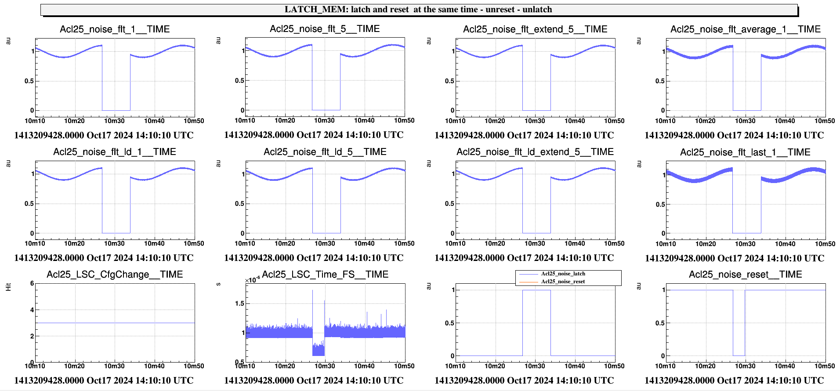
LACTH{,_MEM} - RESET/LATCH priority
Acl version v1r30p17
With the LATCH at 1 , the filter channel computation is still performed : smooth transition when the LATCH is lower than 1.
The reset shape is applied at the input signal and at the output signal
Improve the logic in case of a reset and a latch occurred at the same time: the reset is more priority than the latch, no more filter reset at the unlatch

